Slide 1
Spatial Databases

Slide 2
Spatial Database Components, Spatial Objects
Spatial Dimensions, Spatial Relations, Spatial SQL Queries

Slide 3
What is a Spatial Database?
A SDBMS is a DBMS
It offers spatial data types/data models/ query language
Support spatial properties/operations
It supports spatial data types in its implementation
Support spatial indexing, algorithms for spatial selection and join

Slide 4
Spatial DataBases
The contents of a spatial data base present a particular view of the world.
The user of the spatial data base sees the real world through the medium of the data base, therefore the measurements and samples contained in the data base must be maintained as complete and accurate as possible to present a view of the real world.
The contents of a spatial database are special in terms of:
themes and characteristics captured (attributes),
the time period covered, and
the study area (spatial entities)

Slide 5
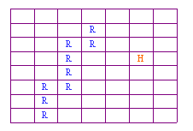
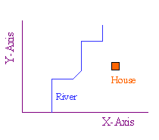
Spatial Representation
Raster model:
Vector model:

Slide 6
Spatial data types
point
region
line
Point : 2 real numbers
Line : sequence of points
Region : area included inside n-points

Slide 7
Spatial Relationships
Topological relationships:
adjacent, inside, disjoint, etc
Direction relationships:
Above, below, north_of, etc
Metric relationships:
“distance < 100”
And operations to express the relationships

Slide 8
The contents of a spatial data base include:
Digital versions of real objects (e.g. lakes),
Digital versions of artificial map features (e.g. contours),
Artificial objects created for the purposes of the data base (e.g. pixels).

Slide 9
Components of Spatial Data
Time:
The temporal mode can be captured in several ways: - by specifying the interval of time over which an object exists, - by capturing information at certain points in time, or - by specifying the rates of movement of objects.
Depending on how the temporal mode is captured, it may be included in a single attribute table, or be represented by series of attribute tables on the same objects through time.
Spatial data model, query language, query processing, file organization and indices, query optimization, etc.

Slide 10
Scales (Levels) of Measurement
Numerical values may be defined with respect to nominal, ordinal, interval, or ratio scales of measurement (or levels of measurement). It is important to recognise the scales of measurement used in spatial data as this determines the kinds of mathematical operations that can be performed on the data.
The different scales can be demonstrated using an example of a marathon race.

Slide 11
SPATIAL RELATIONS
Relations exist between spatial objects like distance, proximity, nearness, contained in etc.
 | Points | Lines | Areas
Points | is a neighbour of is allocated to | is near to lies on | is a centroid of is within
Lines |  | crosses joins | intersects is a boundary of
Areas |  |  | is overlaid by is adjacent to

Slide 12
Examples
A database:
Relation states(sname: string, area: region, spop: int)
Relation cities(cname: string, center: point; ext: region)
Relation rivers(rname: string, route:line)
SELECT * FROM rivers WHERE route intersects R
SELECT cname, sname FROM cities, states WHERE center inside area
SELECT rname, length(intersection(route, California)) FROM rivers WHERE route intersects California

Slide 13
Spatial Queries
Selection queries: “Find all objects inside query q”, inside-> intersects, north
Nearest Neighbor-queries: “Find the closets object to a query point q”, k-closest objects
Spatial join queries: Two spatial relations S1 and S2, find all pairs: {x in S1, y in S2, and x rel y= true}, rel= intersect, inside, etc

Slide 14
Indexing using SAMs
Approximate each region with a simple shape: usually Minimum Bounding Rectangle (MBR) = [(x1, x2), (y1, y2)]
G-tree indexing
B-Tree indexing
y2
y1
x1
x2

Slide 15
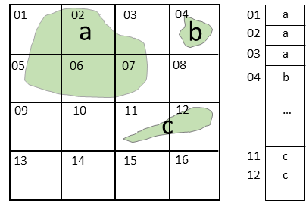
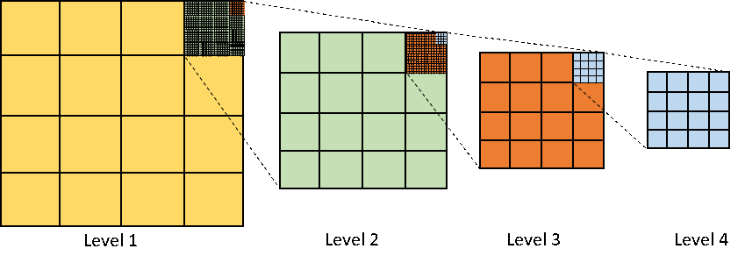
Space-driven Structures
Fixed grid index
Fixed grid index is an n×n array of equal-size cells. Each one is associated with a list of spatial objects which intersect or overlap with the cell. Figure 3 depicts a fixed 4×4 gird indexing a collection of three spatial objects.

Slide 16
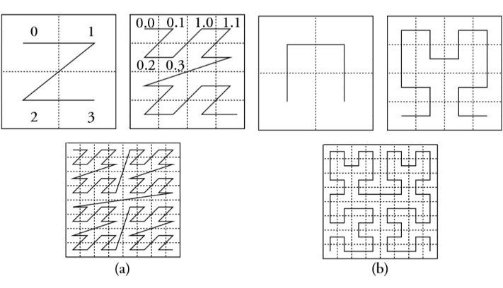
Figure 5. Two common space filing curves: z-order (a) and Hilbert curve (b)
Figure 5. Two common space filing curves: z-order (a) and Hilbert curve (b)

Slide 17
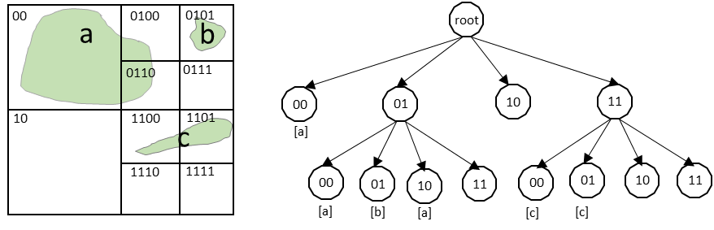
Quadtree
Figure 6. A representation of a quadtree structure.

Slide 18
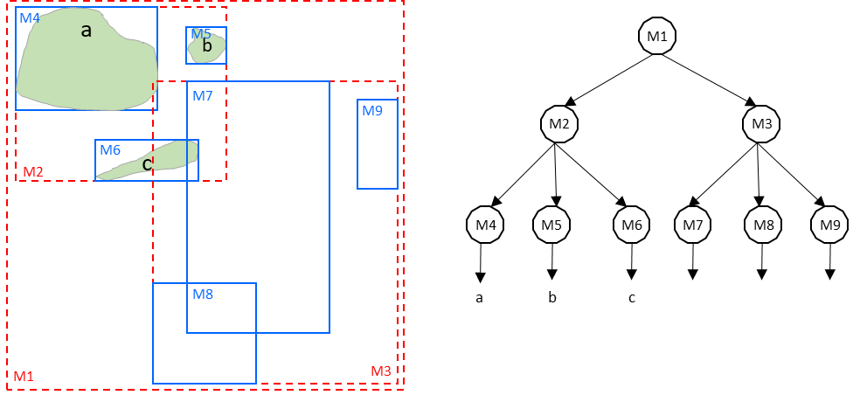
R-tree
For a layer of geometries, an R-tree index consists of a hierarchical index on the MBRs of the geometries in the layer (Guttman, 1984). This hierarchical structure is based on the heuristic optimization of the area of MBRs in each node in order to improve the access efficiency.

Slide 19
Three Layer Architecture

Slide 20
Applications
Solid waste management
Slum area detection
Detection of Buildings
Finding shortest path from trajectory dataset
Detection of airport
Prediction of a location for starting a school
Malaria prone area detection
Road extraction

